Slide 1


Git/GitHub for Data Science
Software Engineering Domain
Garrett Lam and Mihir Joshi
Notes:
both

Slide 2
Overview
 | Version Control Git/Github VS Code Github Desktop Git Clone Git Add/Commit/Push Git Fetch/Status/Pull Git Branch/Checkout/Merge Git Fork/Pull Requests Git Issues Scenarios for Data Science Activity
Notes:
https://kinsta.com/knowledgebase/what-is-github/
garrett

Slide 3

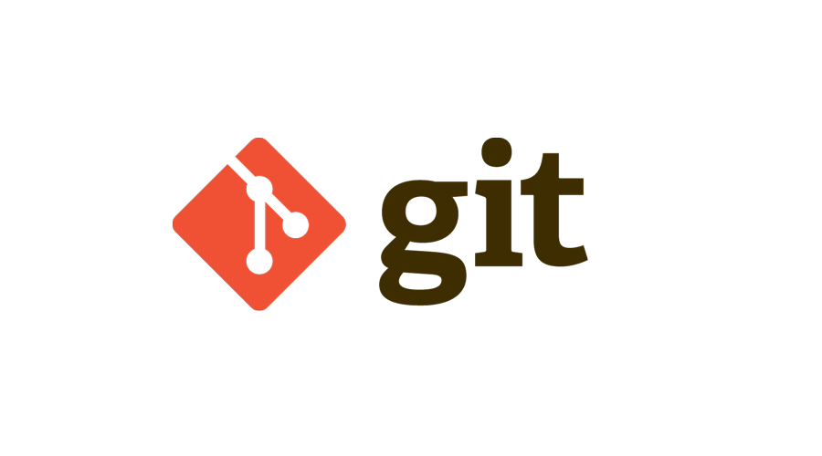

What is version control?
 | A practice of tracking and managing changes to software code (files) Repository (repo): a set of files E.g. Version Control Systems:
Team Foundation Control (TFC)
Notes:
https://kinsta.com/knowledgebase/what-is-github/
garrett

Slide 4

What is Git/Github?
 | Git: a version control system Github: a cloud-based platform where git-based projects are stored (google drive for code)
Notes:
https://kinsta.com/knowledgebase/what-is-github/
garrett

Slide 5
Importance of Github for Data Science
 | Programming happens colaboratory, so it is important to be able to easily share and edit code collectively Continuous Integration Continuous Deployment People can edit files without interference
Notes:
Mihir
Con int allows for different changes to the code to be integrated into a single project
Con dep means that software updates can be automatically published and deployed
Enables each person to edit their own copy of a file and chooses when to share those changes, so one person’s edits do not interfere with another person’s work

Slide 6

Making a Github Account
 | https://github.com
Notes:
Garrett 3:00

Slide 7
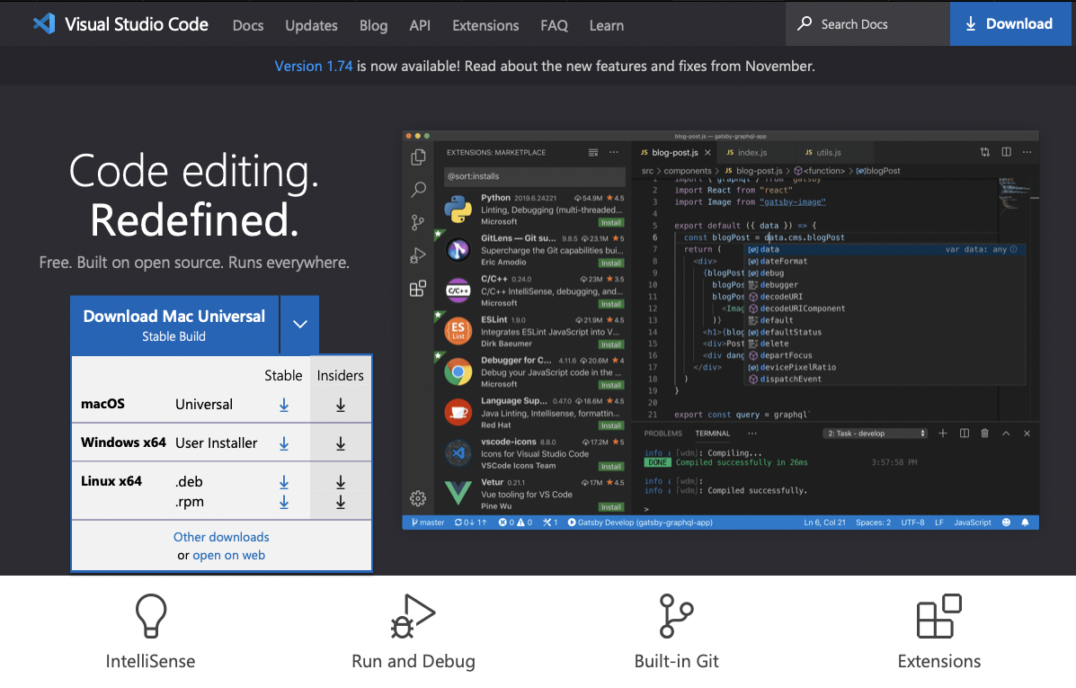
Downloading VS Code
 | https://code.visualstudio.com
Notes:
Garrett 3:30-3:45

Slide 8
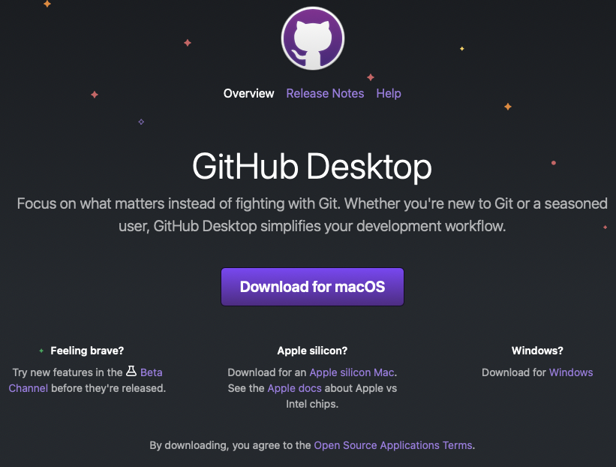
Downloading GitHub Desktop
 | https://desktop.github.com
Notes:
Garrett
GUI
Easier way to commit and pull code
Alternative to Command Line
4:15

Slide 9
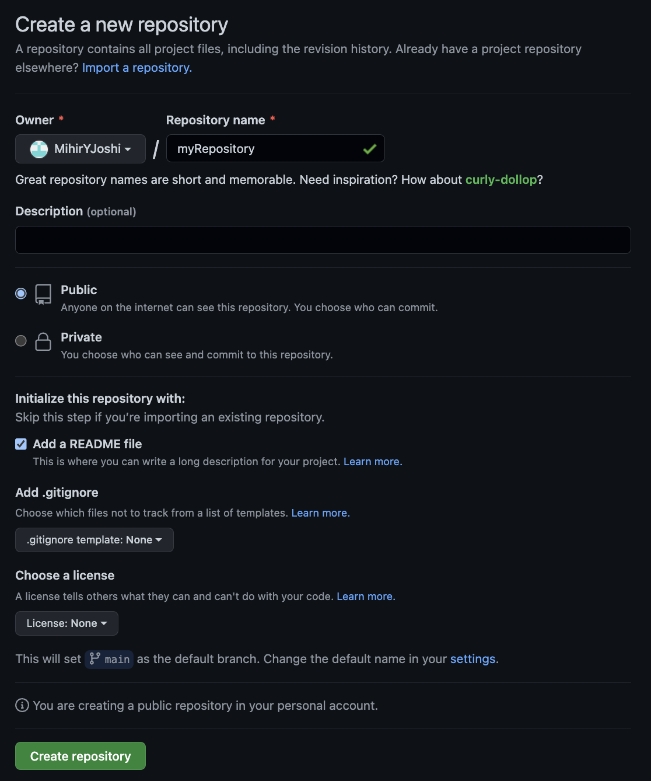
Creating a Repository
 | Private: Access is Restricted to shared people Public: Anyone can access Add a README file High-level description of the Repository Gitignore: Tells Github to ignore those files when committing
Notes:
Mihir
Gitignore - avoid recommiting file - In root directory
Git Keep is used to keep empty directories in github, if a directory is empty github doesn’t let you store it

Slide 10
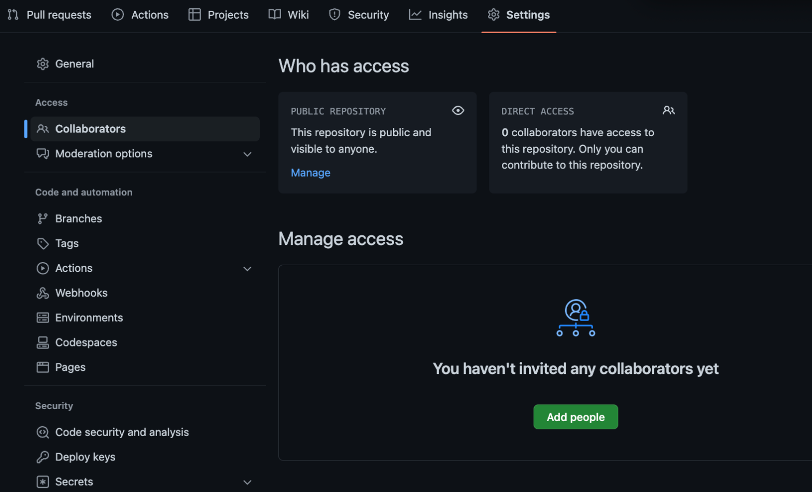
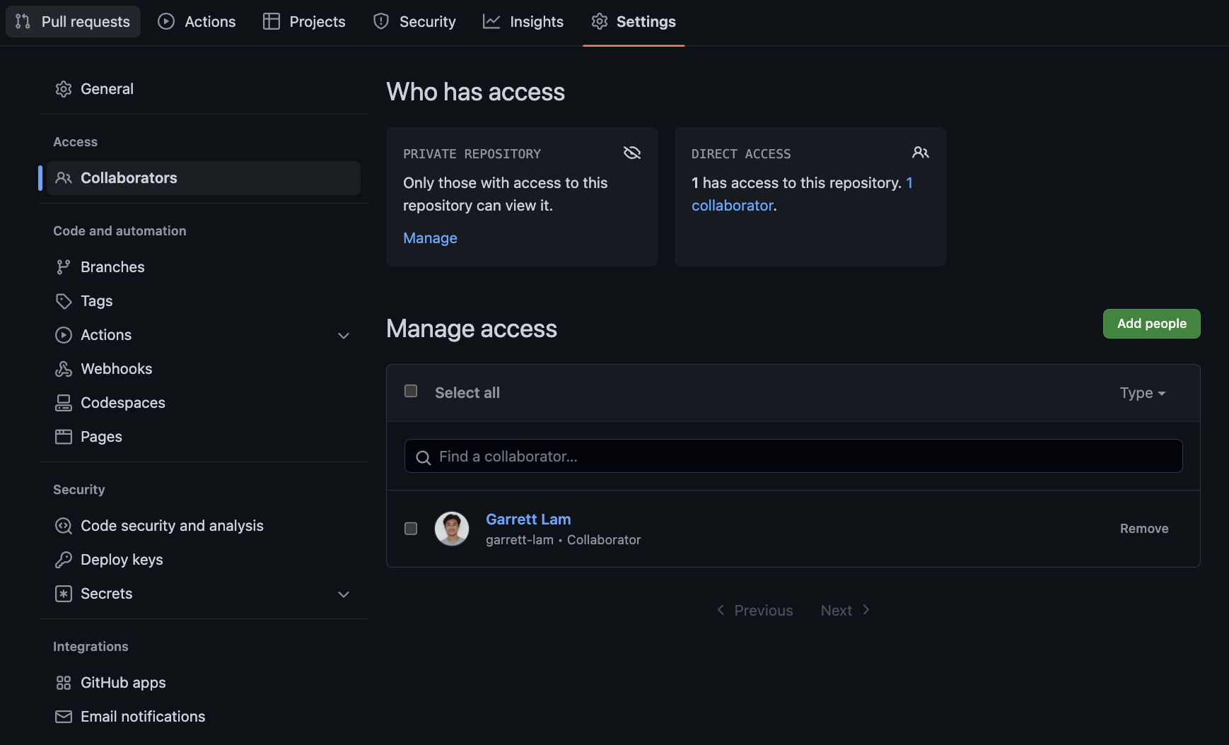
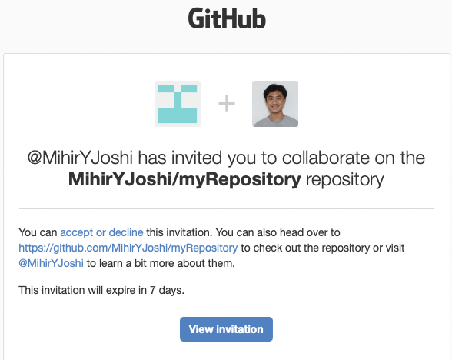
Adding Collaborators
Notes:
Mihir

Slide 11
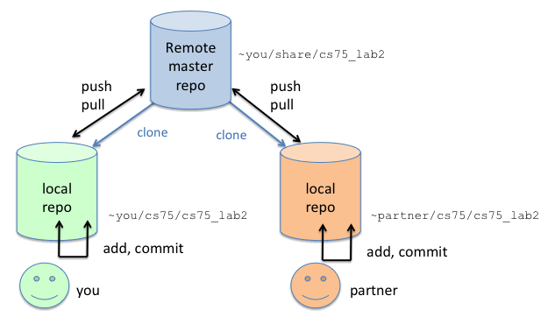
Notes:
Mihir

Slide 12
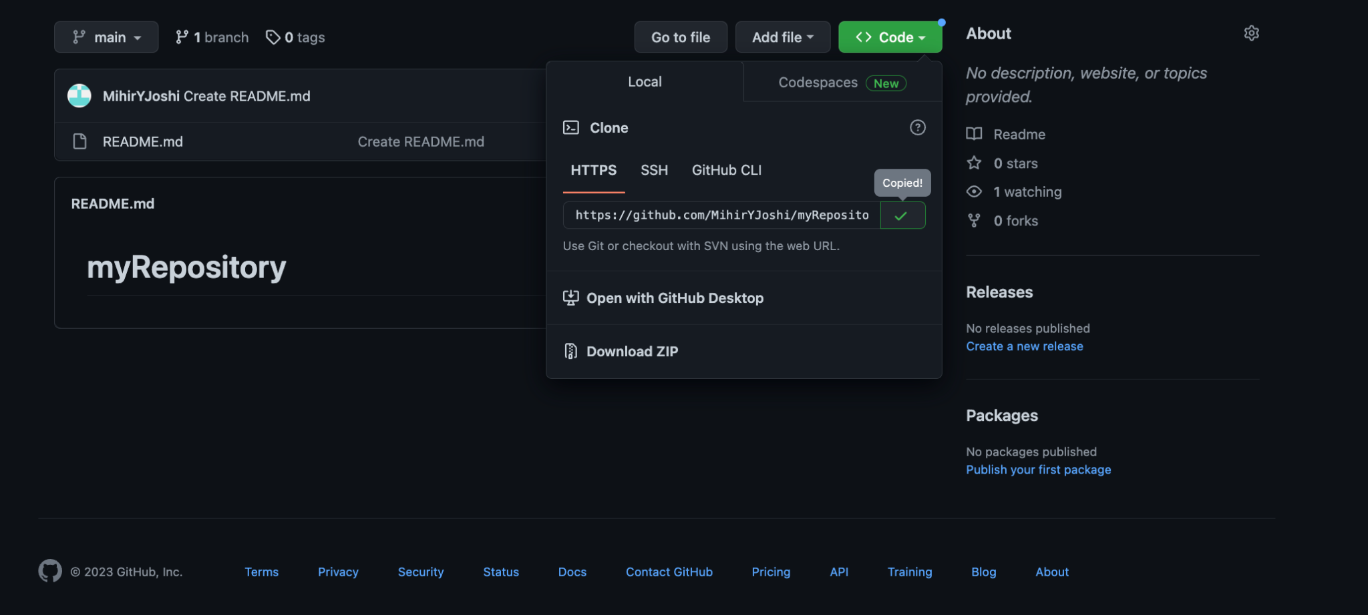
Cloning Repo in VS Code
Notes:
Mihir

Slide 13
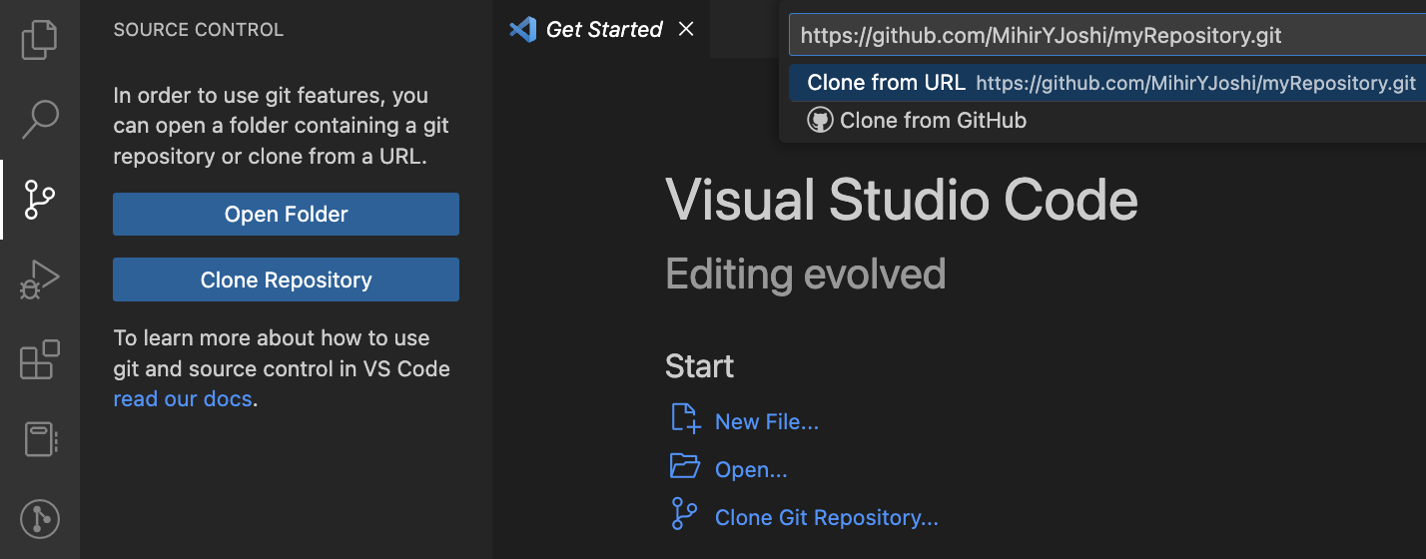
Notes:
Mihir

Slide 14
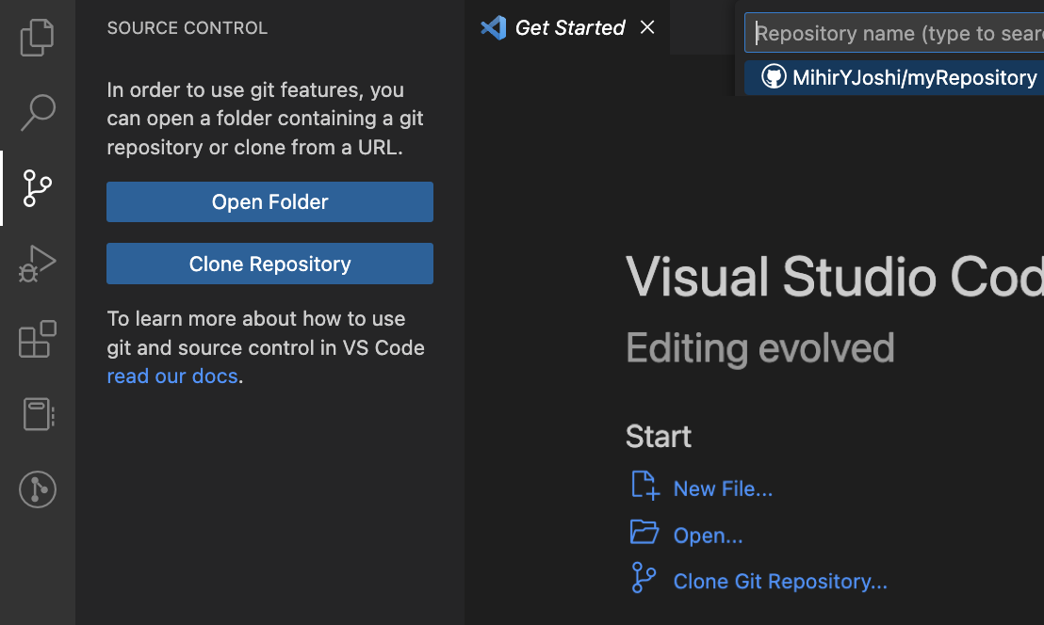
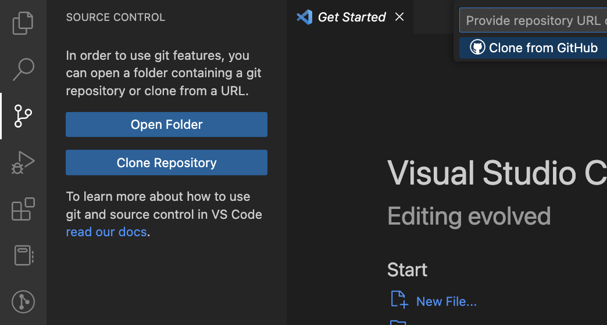
Notes:
Mihir

Slide 15
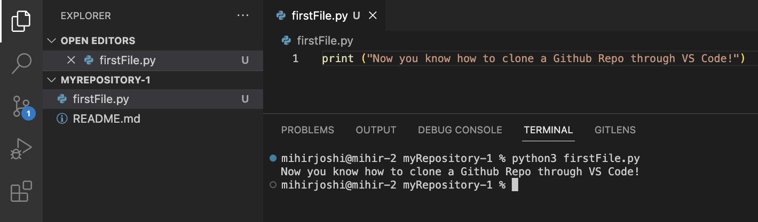
Notes:
Mihir

Slide 16
Cloning Repo in Terminal
Notes:
Mihir

Slide 17
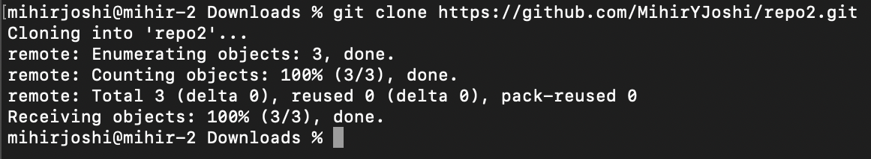
Notes:
Mihir

Slide 18
Notes:
Mihir

Slide 19
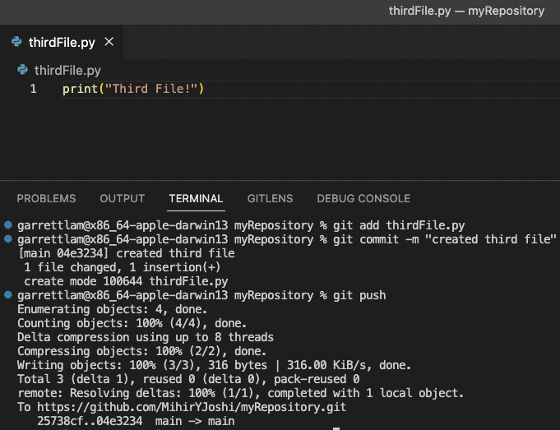
Git Add/Commit/Push: Terminal
Notes:
Mihir

Slide 20
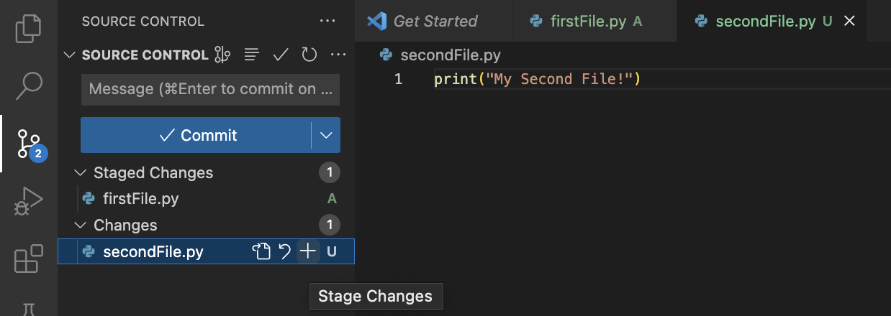
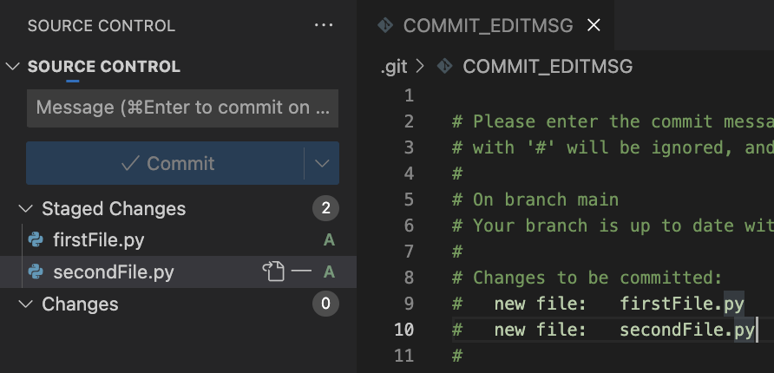
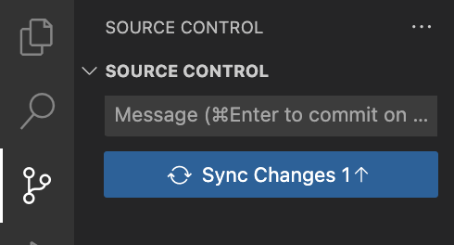
Git Add/Commit/Push: VS Code
 | Click + to Add/Stage Changes Click Commit and Write Commit Comments Close Commit File after writing comment Sync Changes to Push
Notes:
Mihir

Slide 21
Notes:
Mihir

Slide 22
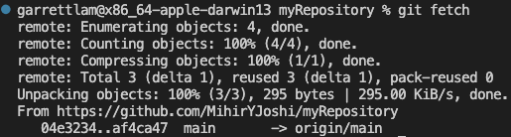
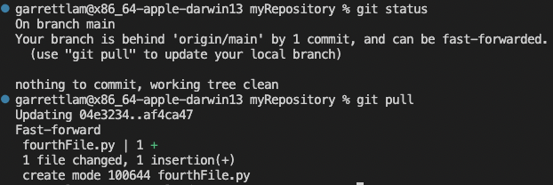
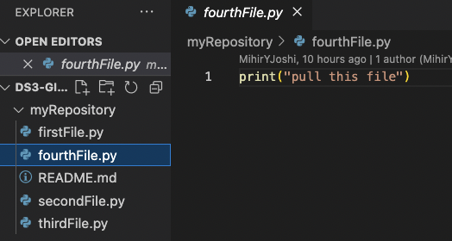
Git Fetch/Status/Pull: Terminal
Downloads contents from remote repo → local repo
Checks for differences between remote and local repo
Update local repo
Notes:
Mihir

Slide 23
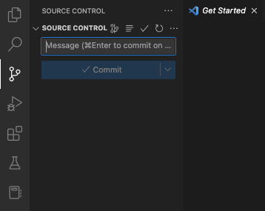
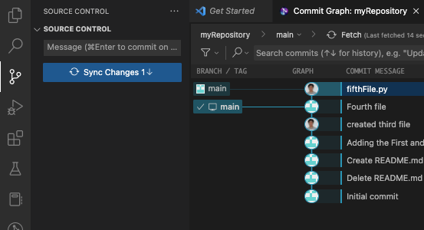
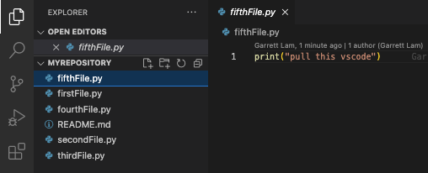
Git Fetch/Status/Pull : VS Code
 | Click to Display Commit Graph Click Fetch to “Refresh” Click Sync Changes to pull the file(s)
Notes:
Mihir

Slide 24
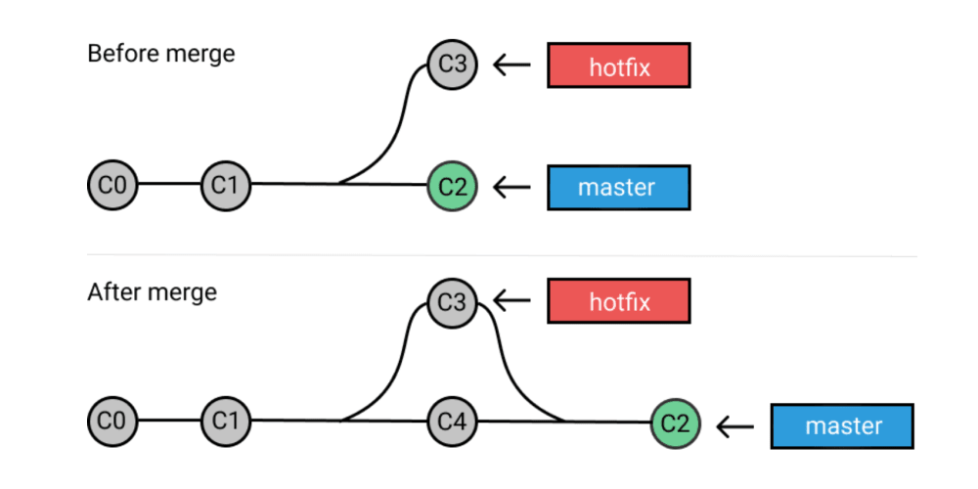
Scenario:
You are working on a data science project or application as a developer and you wanted to create a new feature but you are not sure if it will work
Branch → work on feature → test out feature → Merge to main branch
branch, checkout
(Official Working Version of your project)
merge
Notes:
Garrett

Slide 25
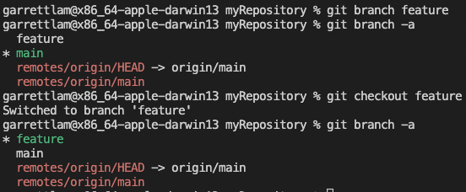
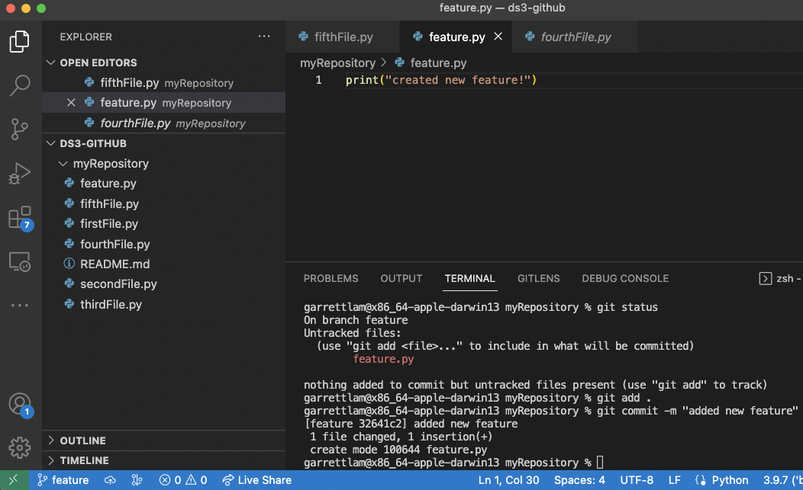
Git Branch/Checkout/Merge: Terminal
 | Git checkout: used to switch been branches Creating files on feature branch will NOT show up on main branch (before merge)
Notes:
Garrett
Branching and Merge typically used for adding new features:
Branch to test out feature
Files added and committed to feature branch will not show up on main branch

Slide 26
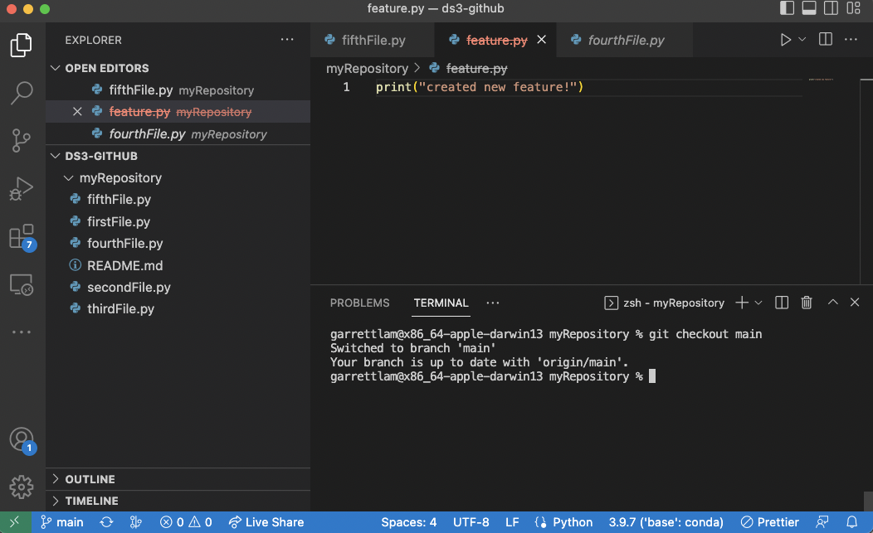
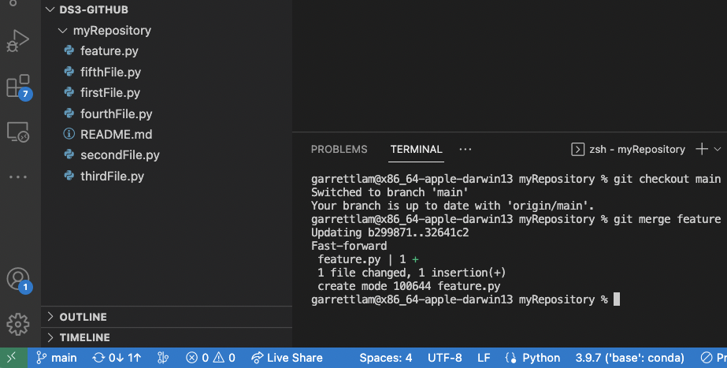
 | Switch back to main branch to merge! Feature file not on main branch Feature.py not in repo (when switched back to main branch)
Notes:
garrett

Slide 27
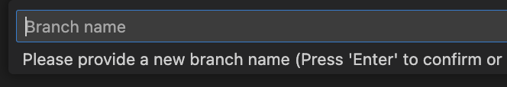
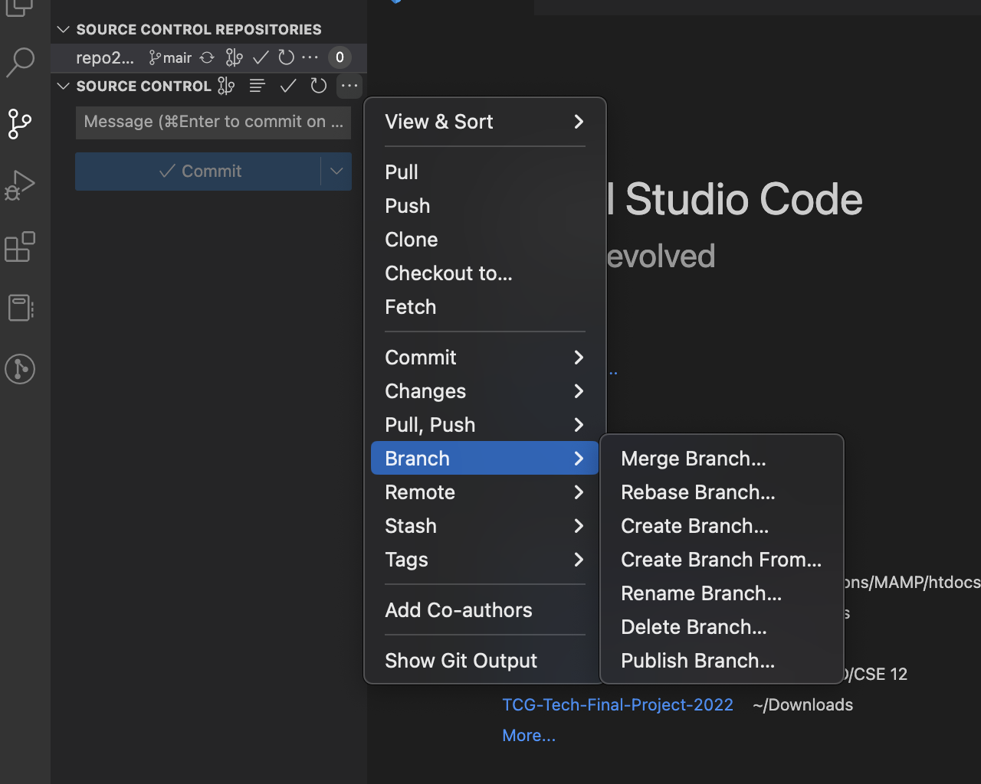
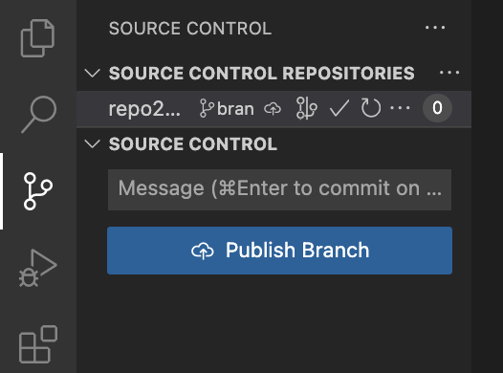
Git Branch: VS Code
Publish branch just uploads to Github
Notes:
garrett

Slide 28
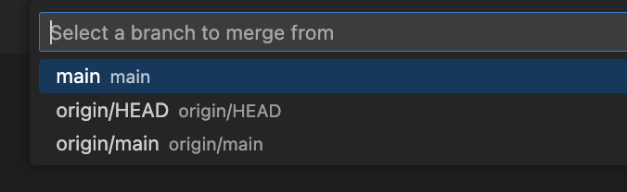
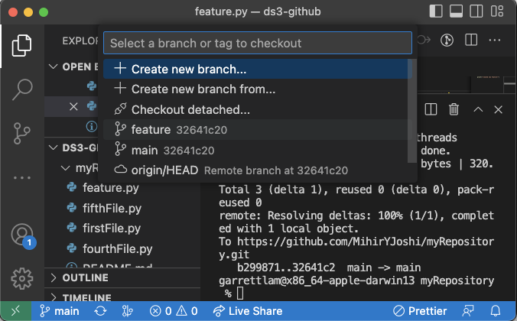
Git Checkout/Merge: VS Code
Git Merge
Git Checkout
Notes:
garrett

Slide 29
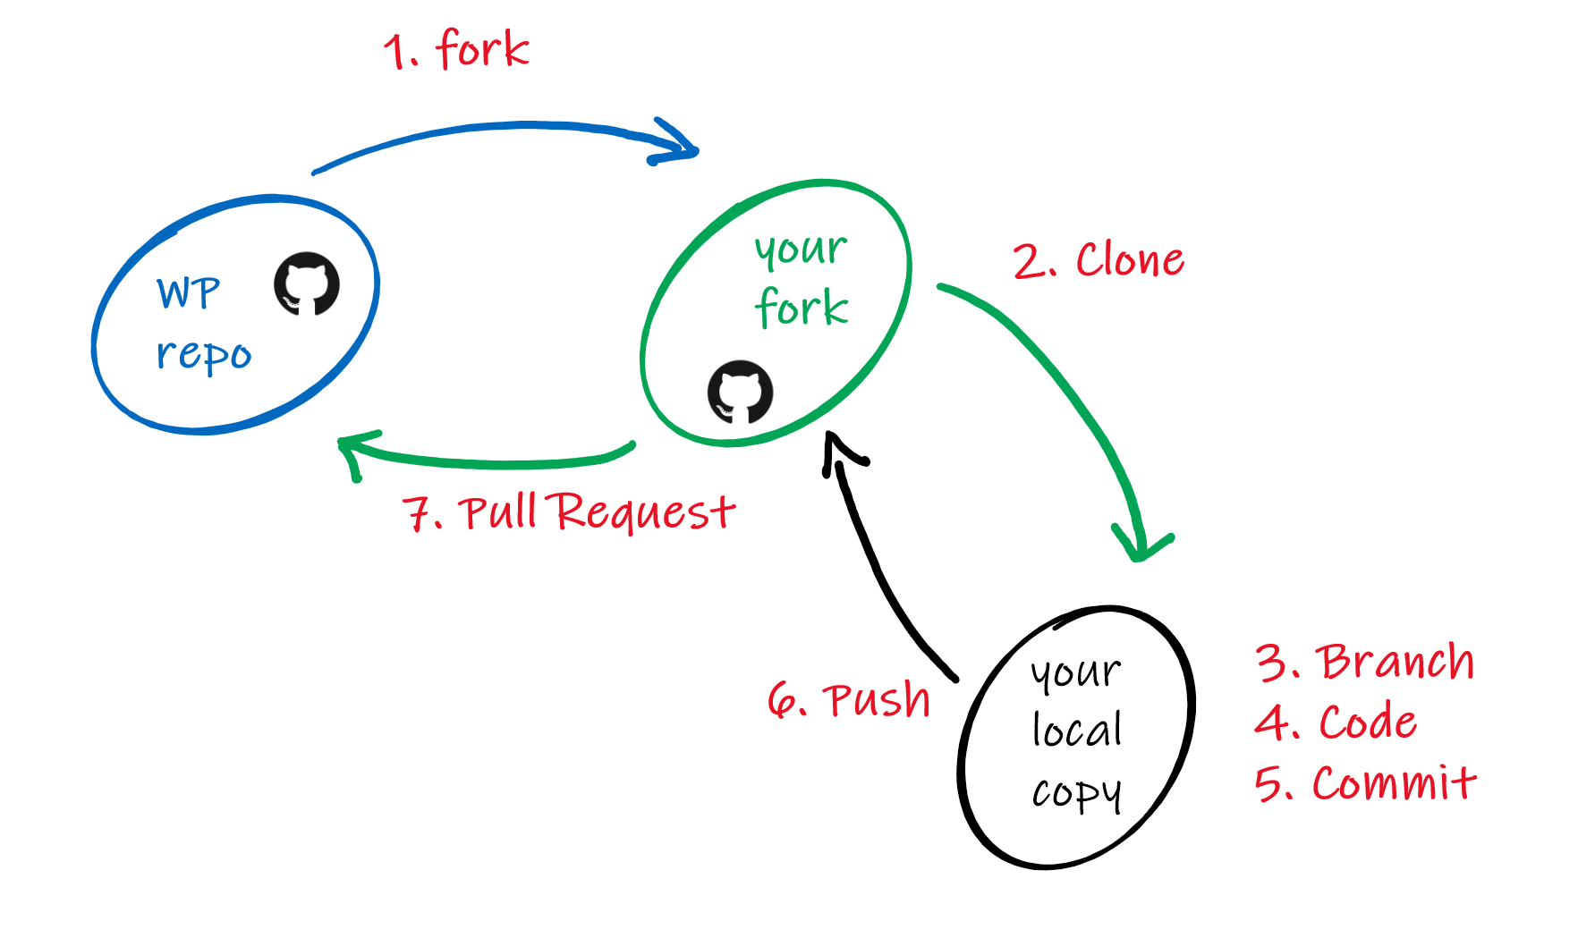
Scenario:
Mihir: created an AI chatbot (like ChatGPT) to be used by public
Garrett (random person on internet): wanted to improve it
changes here are indirect!
Notes:
Garrett
Fork:
Way to make a copy of a repo
Allows you to make indirect changes to a repo you are not a collaborator on

Slide 30
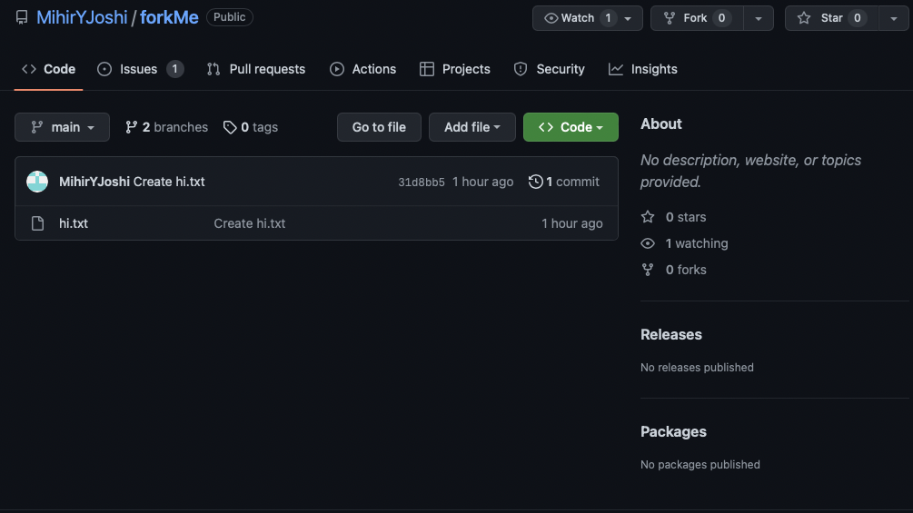
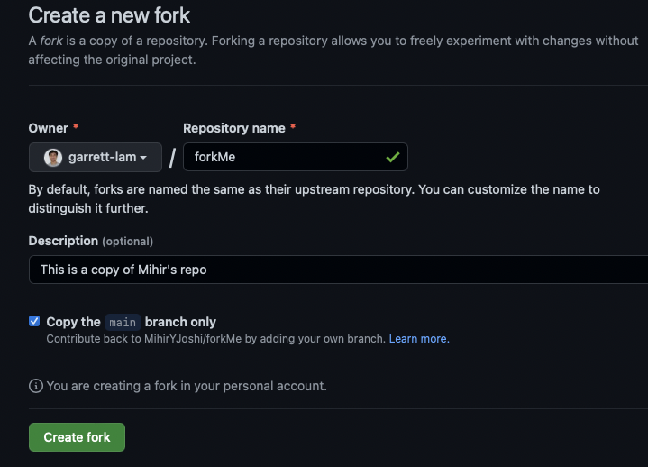
Git Fork
Garrett POV:
Git Fork: making a copy of someone’s repository (that you are NOT a collaborator on)
Notes:
Garrett
Explain scenario

Slide 31
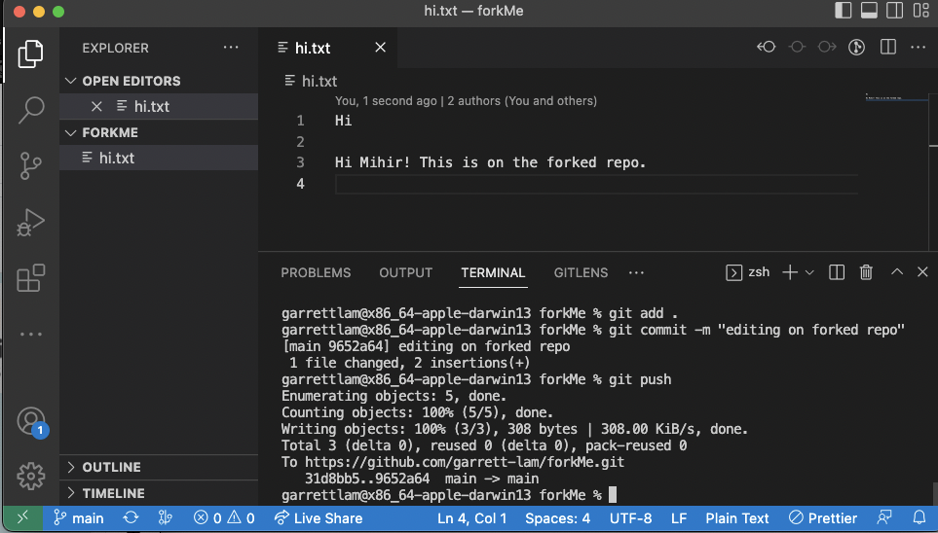
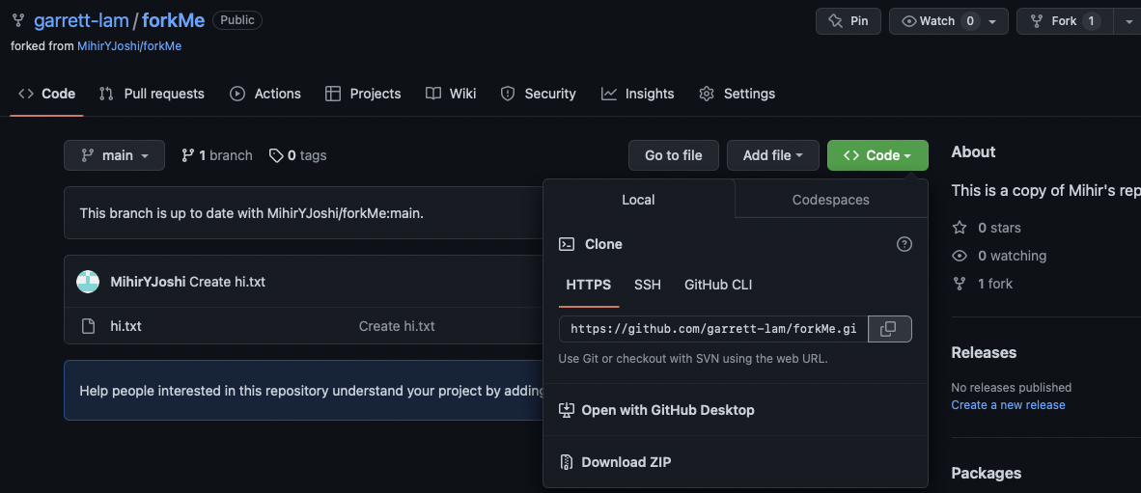
Garrett POV: write code to improve Mihir’s code on forked repo
Git Add/Commit/Push
Git Clone
Notes:
garrett

Slide 32
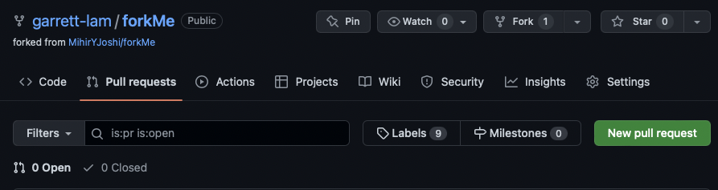
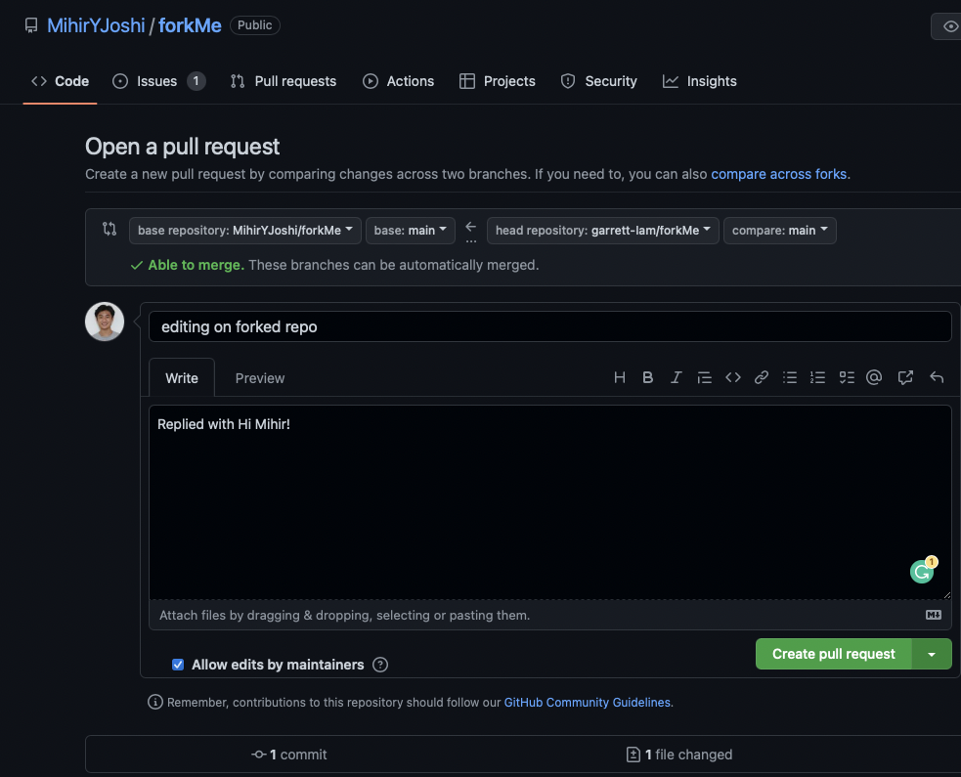
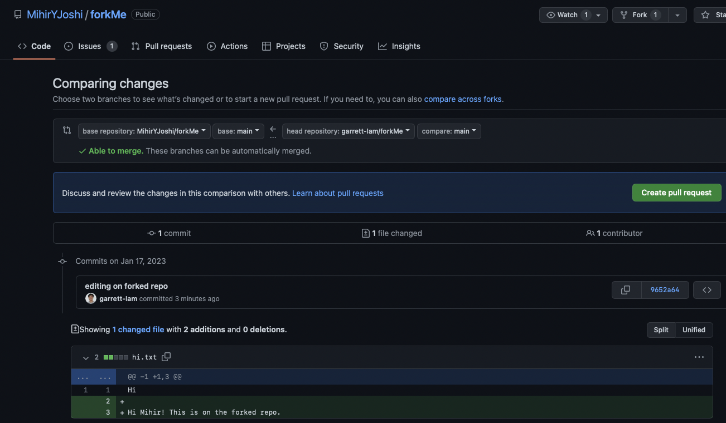
Git Pull Request
“I want my improvements to show up on the original repo!”
Pull Request: similar to Git merge but needs to be approved by original repo owner
Notes:
garrett

Slide 33
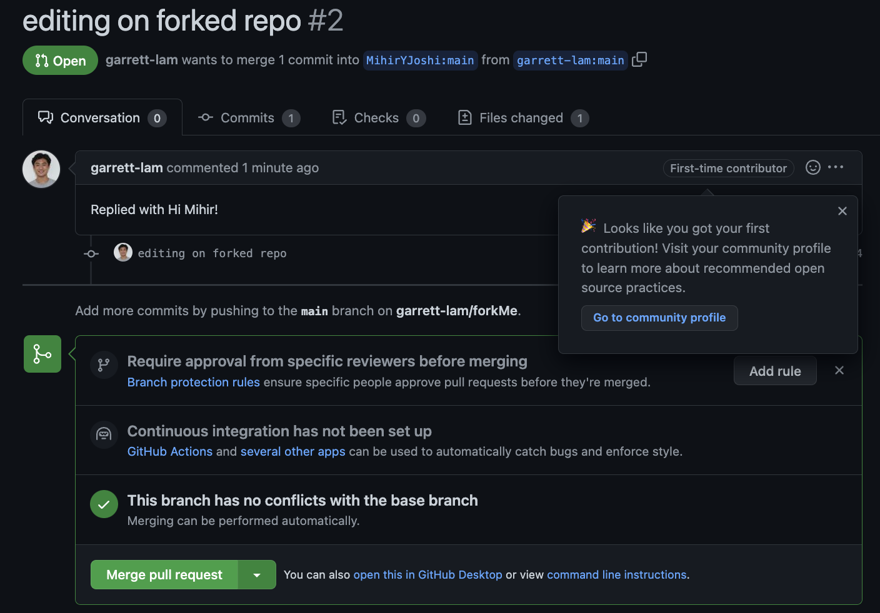
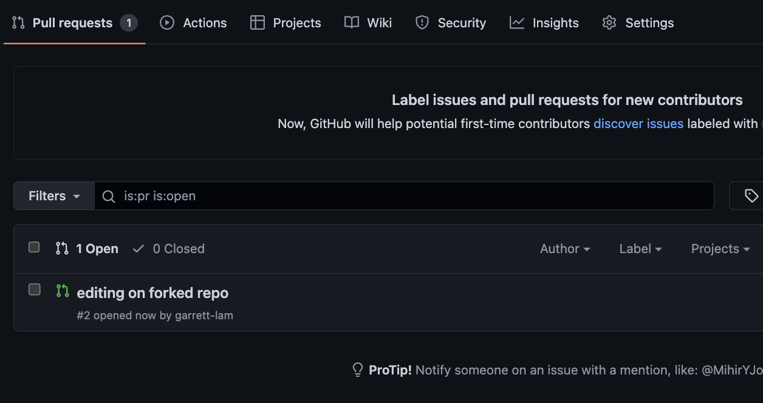
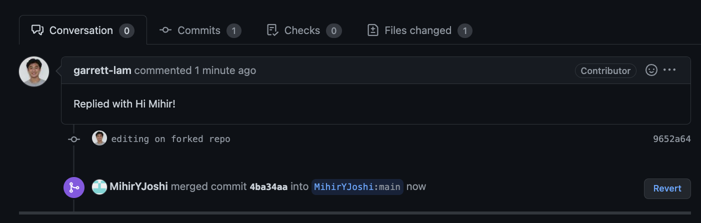
Mihir’s POV: review changes → accepting pull request
Notes:
garrett

Slide 34
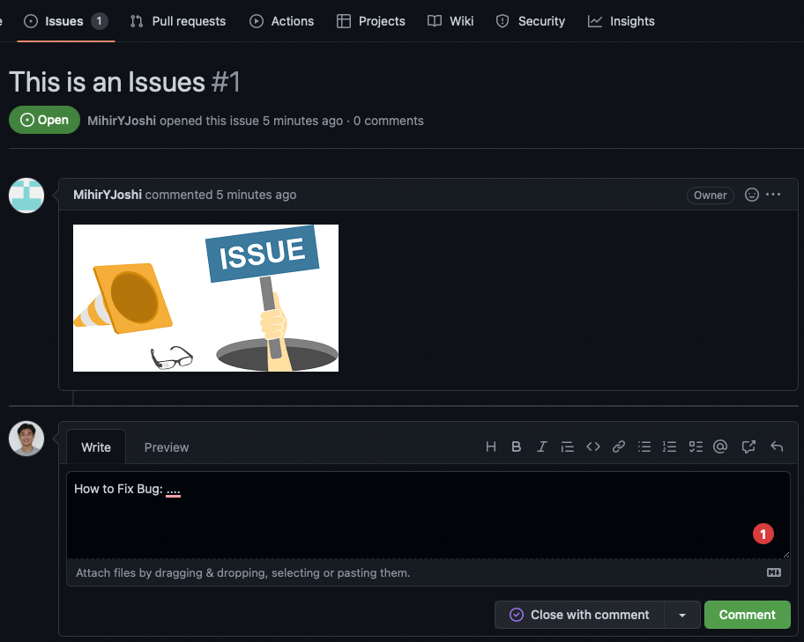
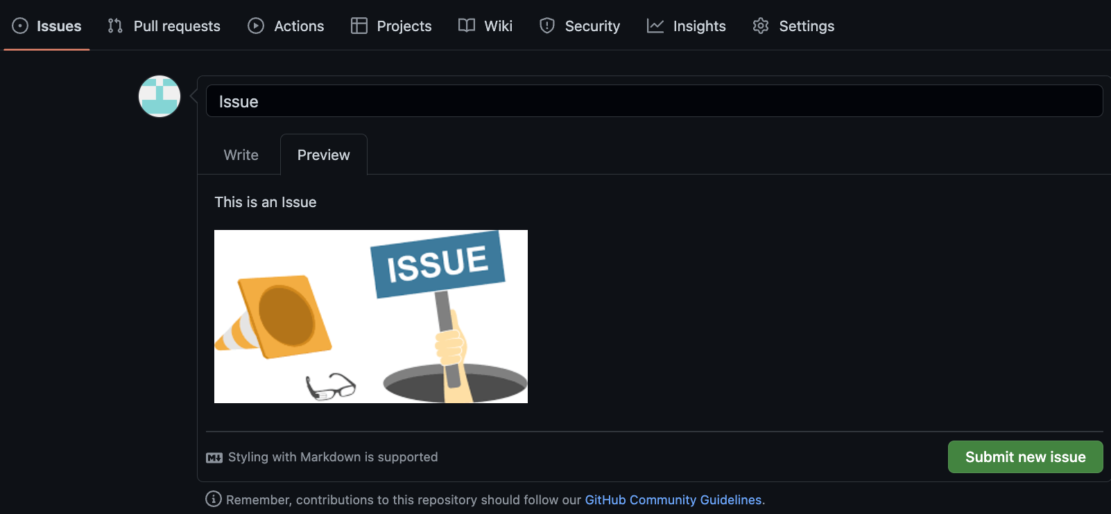
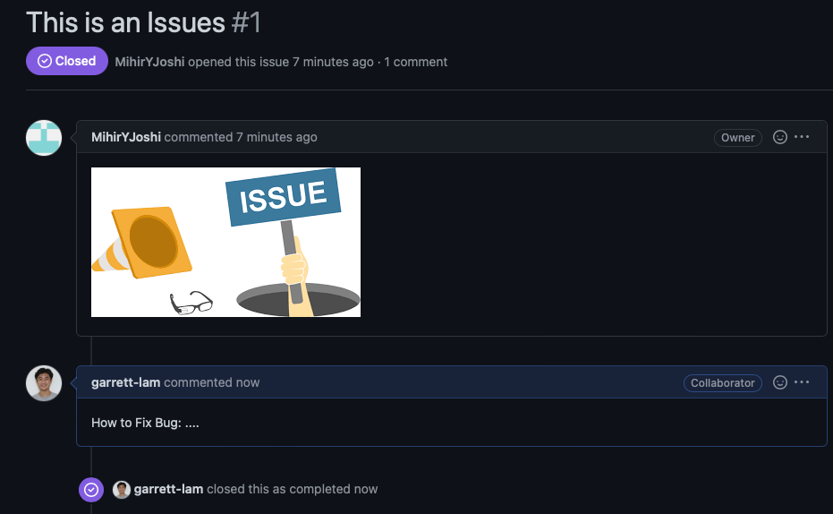
Git Issues
Way for non-collaborators to let original repo owner they have issues with using their tool OR if there are any bugs
Notes:
garrett

Slide 35
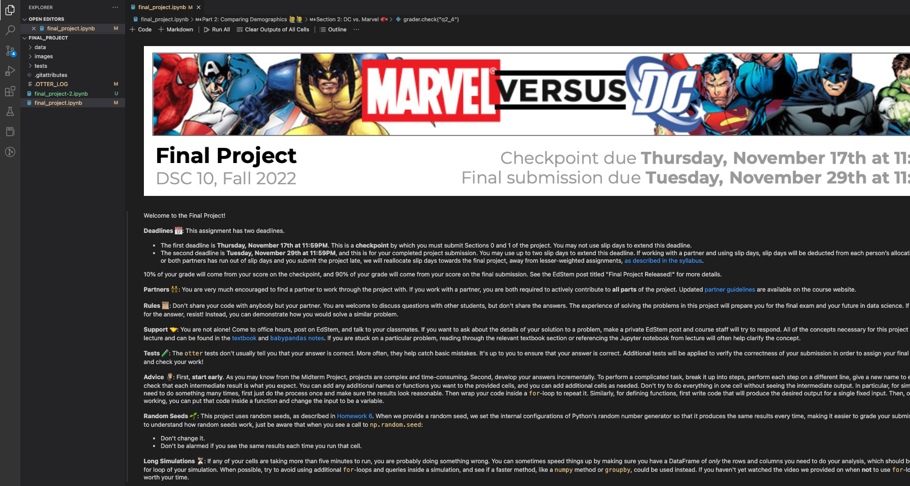
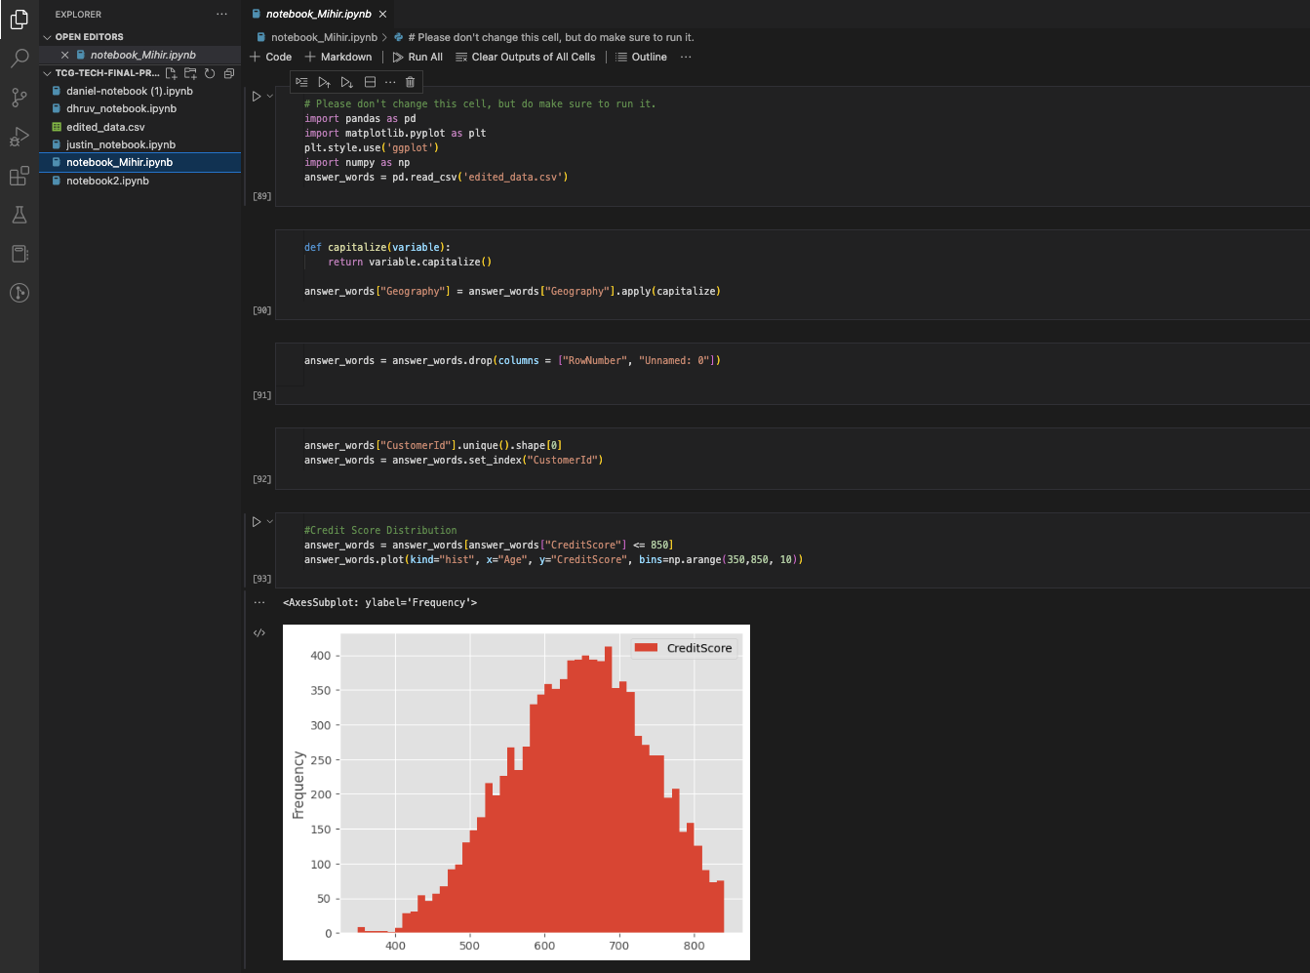

Scenarios for Data Science
 | Work on Python Notebooks in VS Code .ipynb files are Jupiter Notebooks
Notes:
Mihir
Random forest mode
Data science projects

Slide 36

Create an Empty Directory
 | Mkdir to create a folder Cd to move into it Use .gitkeep
Notes:
Mihir

Slide 37

.gitignore
 | Add file to gitignore Ignores file
Notes:
Mihir

Slide 38
Now it’s your turn!
Create Github Account
Download VS Code and Github Desktop
Pair up and make a repo
Add your teammates as collaborators
Start off with:
Person A: Git Add/Commit/Push a file
Person B: Git Fetch/Status/Pull the file
Then try out Git Branch/Checkout/Merge individually
If you have time (Git Fork/Pull Requests):
Person A: Make a brand new repo
Person B: Fork the repo, make changes, make pull request
Person A: Review pull request, and merge to original repo!
Notes:
garrett

Slide 39


Feedback
Notes:
lauren

